Slide 1

多媒体系统导论 Fundamentals of Multimedia System
授课教师：文嘉俊
邮箱：wenjiajun@szu.edu.cn
2022年春季课程

Slide 2
Outline of Lecture 08
Introduction-简介
Distortion Measures-失真度量
The Rate-Distortion Theory-比率失真理论
Quantization-量化
Uniform Scalar Quantization-均匀标量量化
Nonuniform Scalar Quantization-非均匀标量量化
Vector Quantization-向量量化
Transform Coding-变换编码
Wavelet-Based Coding-小波编码
Experiments-实验

Slide 3
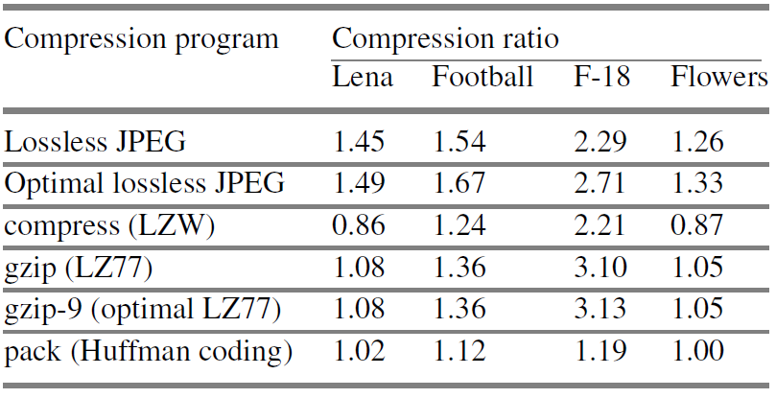
Introduction-简介
What is lossy compression-什么是有损编码

Slide 4
Introduction-简介
What is lossy compression-什么是有损编码
Lossless compression algorithms do not deliver compression ratios that are high enough. Hence, most multimedia compression algorithms are lossy-无损编码压缩率不高，多媒体应用需较高压缩率.
Lossy Compression: The compressed data is not the same as the original data, but a close approximation of it-不完全相同，但感知上近似.
Yields a much higher compression ratio than that of lossless compression-较高压缩率.

Slide 5

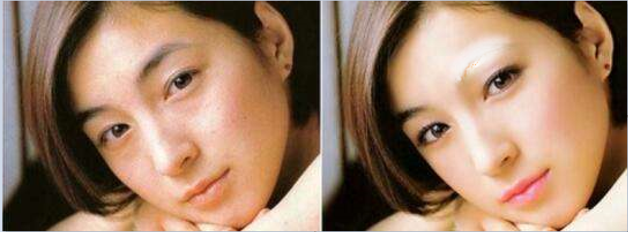
Introduction-简介
What is lossy compression-什么是有损编码

Slide 6
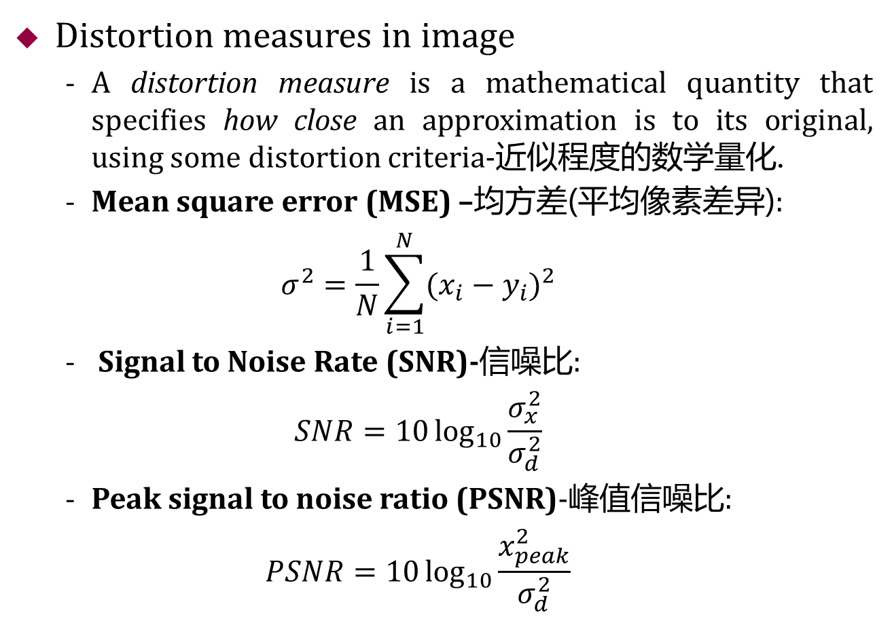
Distortion Measures-失真度量
Distortion measures in image
A distortion measure is a mathematical quantity that specifies how close an approximation is to its original, using some distortion criteria-近似程度的数学量化.
Mean square error (MSE) –均方差(平均像素差异):
$$σ^{2}=\frac{1}{N}\sum_{i=1}^{N}{{(x_{i}−y_{i})}^{2}}$$
Signal to Noise Rate (SNR)-信噪比:
$$SNR=10\log_{10}{\frac{σ_{x}^{2}}{σ_{d}^{2}}}$$
Peak signal to noise ratio (PSNR)-峰值信噪比:
$$PSNR=10\log_{10}{\frac{x_{peak}^{2}}{σ_{d}^{2}}}$$
原始值
解压值
原数据均方
均方差
原始数据最大值

Slide 7
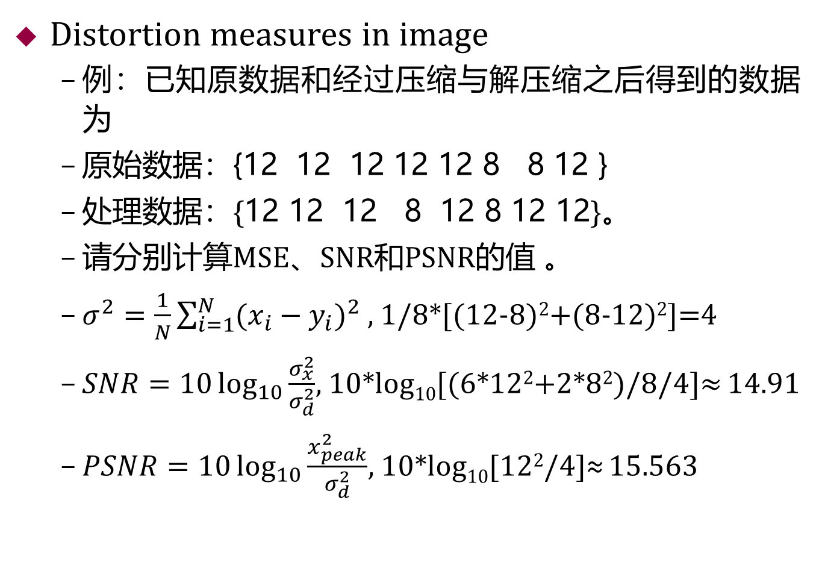
Distortion Measures-失真度量
Distortion measures in image
例：已知原数据和经过压缩与解压缩之后得到的数据为
原始数据：{12 12 12 12 12 8 8 12 }
处理数据：{12 12 12 8 12 8 12 12}。
请分别计算MSE、SNR和PSNR的值 。
$σ^{2}=\frac{1}{N}\sum_{i=1}^{N}{{(x_{i}−y_{i})}^{2}}$ $,$ 1/8*[(12-8)²+(8-12)²]=4
$SNR=10\log_{10}{\frac{σ_{x}^{2}}{σ_{d}^{2}}}$, 10*log₁₀[(6*12²+2*8²)/8/4]≈ 14.91
$PSNR=10\log_{10}{\frac{x_{peak}^{2}}{σ_{d}^{2}}}$, 10*log₁₀[12²/4]≈ 15.563

Slide 8




Distortion Measures-失真度量
原图像
均方根误差
5.17
均方根误差
15.67
均方根误差
14.17

Slide 9
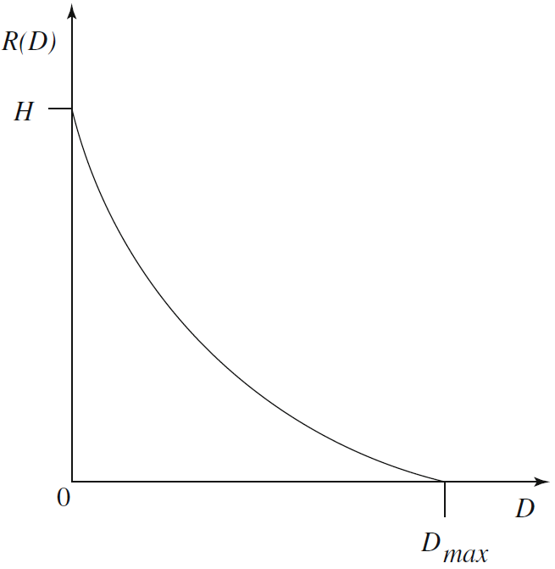
The Rate-Distortion Theory-比率失真理论
Tradeoffs between Rate and Distortion-平衡
Rate is the average number of bits required to represent each source symbol-位数vs失真.
比率-失真函数
有什么作用？
失真容忍度
典型的比率-失真函数
Notes:
失真度量——信号的失真程度
一般用均方差等进行失真度量
比率：重现原信号所需的平均位数，越低越好
D是失真容忍度，失真容忍量，若D=0，即无损压缩方法
R(D)表示源数据编码的最低比率，当D=0时也就没有损失时的最小比率是源数据的熵
当R(D)恒等于0时，失真达到最大值，
比率-失真函数可以描述编码算法性能的基本限制

Slide 10
Outline of Lecture 08
Introduction-简介
Distortion Measures-失真度量
The Rate-Distortion Theory-比率失真理论
Quantization-量化
Uniform Scalar Quantization-均匀标量量化
Nonuniform Scalar Quantization-非均匀标量量化
Vector Quantization-向量量化
Transform Coding-变换编码
Wavelet-Based Coding-小波编码
Experiments-实验

Slide 11
Quantization-量化
Further understanding quantization
Quantization is the heart of any lossy scheme-量化是任何有损方案的核心.
Reduce the number of distinct output values to a much smaller set-不同输出值的数量减少到一个更小的集合.
Main source of the “loss” in lossy compression-信息损失主要来源.
f: {0, 1, 2, …32, …, 64, …, 94, …, 128, …, 192, …, 255}
f’ : {0, 64, 128, 192, 255}
Uniform/nonuniform scalar quantization-均匀/非均匀
Vector quantization-向量量化(LZW编码)

Slide 12
Quantization-量化
Uniform Scalar Quantization-均匀标量量化
A uniform scalar quantizer partitions the domain of input values into equally spaced intervals, except possibly at the two outer intervals-输入值的域划分为等间隔的区间.
The endpoints of partition intervals are called the quantizer’s decision boundaries-区间端点称决策边界.
The length of each interval is referred to as the step size, denoted by the symbol Δ-区间长短称为步长.
Two types of uniform scalar quantizers: Midrise and Midtread Quantizers-中高型和中宽型均匀量化器
The goal for the design of a successful uniform quantizer is to minimize the distortion for a given source input with a desired number of output values by adjusting the step size Δ to match the input -调整步长，匹配输入，最小化失真.

Slide 13
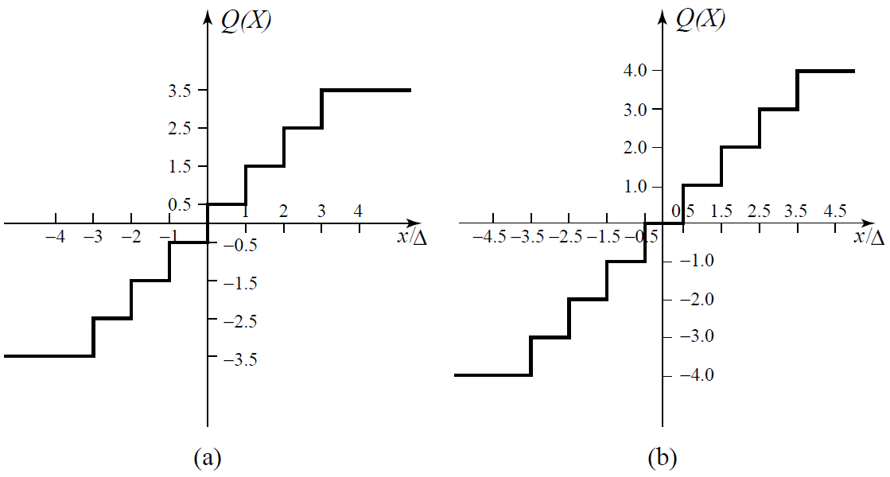


Quantization-量化
Uniform Scalar Quantization-均匀标量量化
中高型
偶数级
中宽型
奇数级
数据在0附近较集中，选何种类型误差更少？
Uniform Scalar Quantizers: (a) Midrise, (b) Midtread
Notes:
当数据源以很小的正数和负数之间的波动表示零值时，中宽型量化器就很有用了。

Slide 14
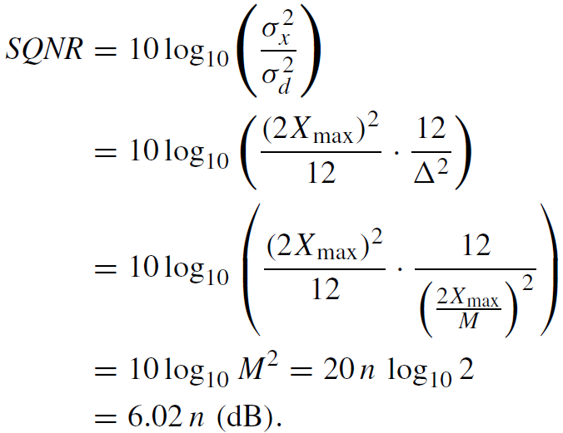
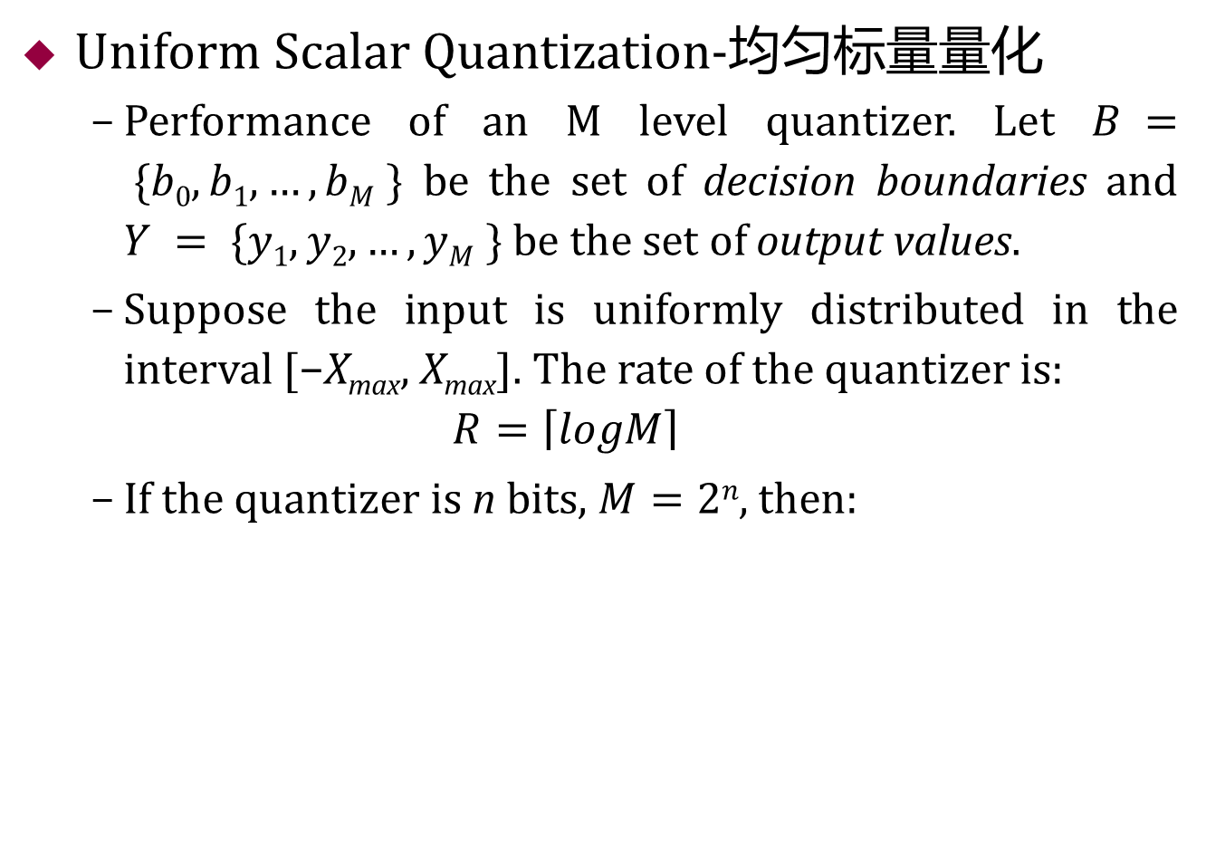
Quantization-量化
Uniform Scalar Quantization-均匀标量量化
Performance of an M level quantizer. Let $B = \{b0, b1, …, bM \}$ be the set of decision boundaries and $Y = \{y1,y2, …, yM \}$ be the set of output values.
Suppose the input is uniformly distributed in the interval [−X_{max}, X_{max}]. The rate of the quantizer is:
$$R=\left\lceil logM\right\rceil$$
If the quantizer is n bits, $M=2n$, then:

Slide 15
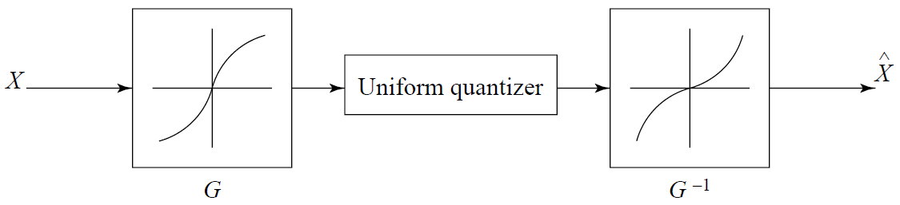
Quantization-量化
Nonuniform Scalar Quantization-非均匀标量量化
Nonuniform quantization is nonlinear-非线性
Companded quantization: a compander consists of a compressor function G, a uniform quantizer, and an expander function G⁻¹-压缩扩展量化器
μ律和A律压缩扩展器

Slide 16
Quantization-量化
Vector Quantization-向量量化
According to Shannon‘s original work on information theory, any compression system performs better if it operates on vectors or groups of samples rather than individual symbols or samples-非单个样本更好.
Form vectors of input samples by simply concatenating a number of consecutive samples into a single vector-一系列样本形成向量.
Instead of single reconstruction values as in scalar quantization, in VQ code vectors with n components are used. A collection of these code vectors form the codebook-向量量化码有n个分量，向量码的集合形成码本.

Slide 17
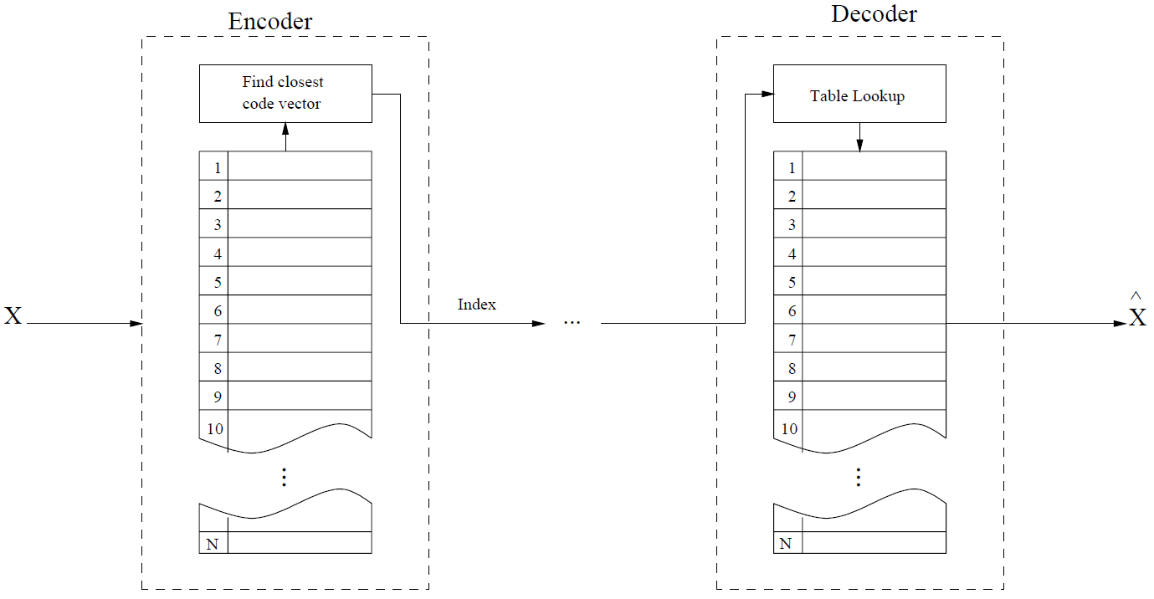
Quantization-量化
Vector Quantization-向量量化
LZW和颜色查找表
许多多媒体应用采用（检索）
Basic vector quantization procedure

Slide 18
Outline of Lecture 08
Introduction-简介
Distortion Measures-失真度量
The Rate-Distortion Theory-比率失真理论
Quantization-量化
Uniform Scalar Quantization-均匀标量量化
Nonuniform Scalar Quantization-非均匀标量量化
Vector Quantization-向量量化
Transform Coding-变换编码
Wavelet-Based Coding-小波编码
Experiments-实验

Slide 19
Transform Coding-变换编码
The rationale behind transform coding-动机
Coding vectors is more efficient than coding scalar-向量编码更有效.
If Y is the result of a linear transform T of the input vector X, i.e. Y=T(X) in such a way that the components of Y are much less correlated, then Y can be coded more efficiently than X-对线性变换T后的Y进行编码比原数据X更有效——变换编码原理.
If most information is accurately described by the first few components of a transformed vector, then the remaining components can be coarsely quantized, or even set to zero, with little signal distortion-大部分信息集中在前几个分量，其它分量可能更粗精度量化，甚至置0.

Slide 20
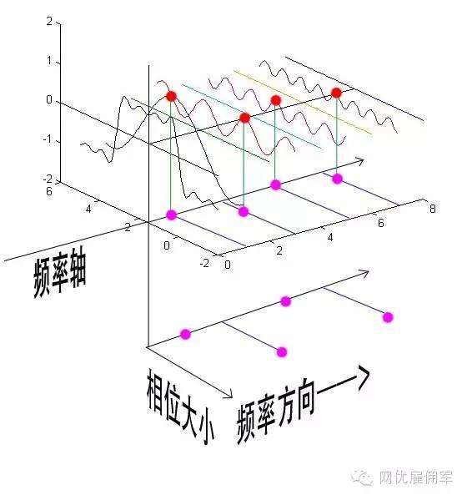
Transform Coding-变换编码
The rationale behind transform coding-动机
An example: DFT-离散Fourier变换.
https://www.bilibili.com/video/BV1pW411J7s8?from=search&seid=15953141356053172266
Notes:
把信号的规律，如频率，大小等转化到频域上进行表示。

Slide 21
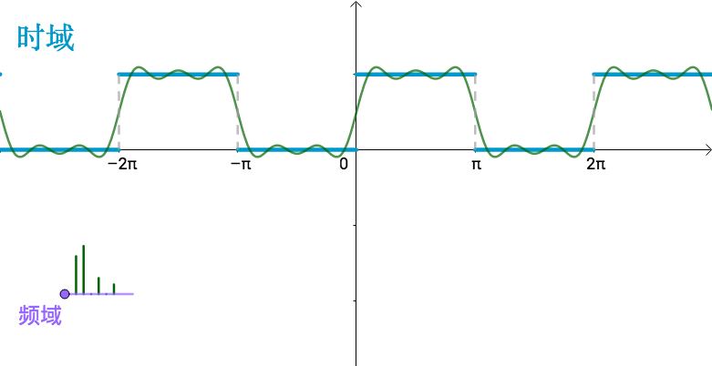
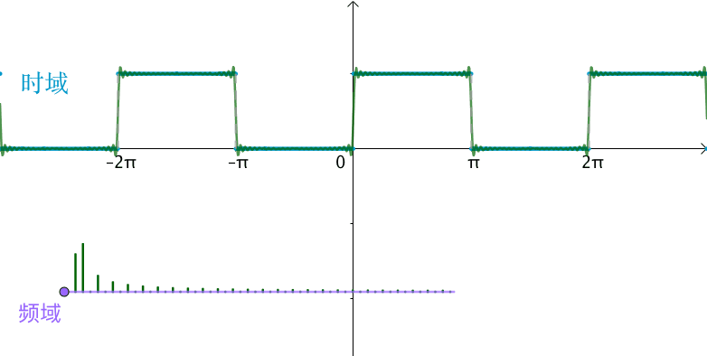
Transform Coding-变换编码
The rationale behind transform coding-动机
An example: DFT-离散Fourier变换.

Slide 22
Transform Coding-变换编码
Discrete Cosine Transform (DCT)-离散余弦变换
Spatial frequency indicates how many times pixel values change across an image block-图像块像素值变化通过空间频率反映.
The DCT formalizes this notion with a measure of how much the image contents change in correspondence to the number of cycles of a cosine wave per block-余弦函数反映图像内容变化.
The role of the DCT is to decompose the original signal into its DC and AC components; the role of the IDCT is to reconstruct (re-compose) the signal- DCT分解原始信号为直流DC分量和交流AC分量， IDCT为逆变换.

Slide 23

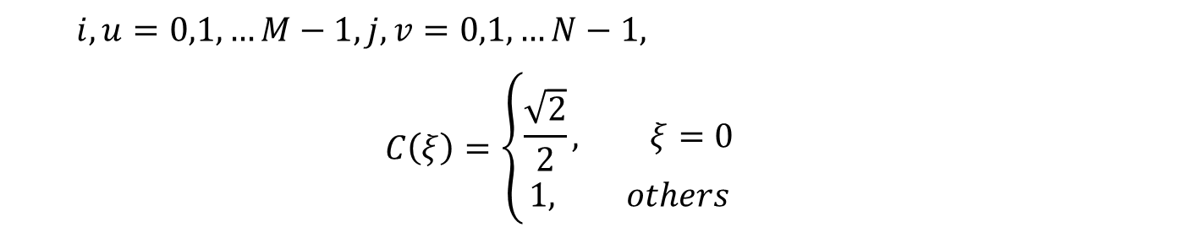
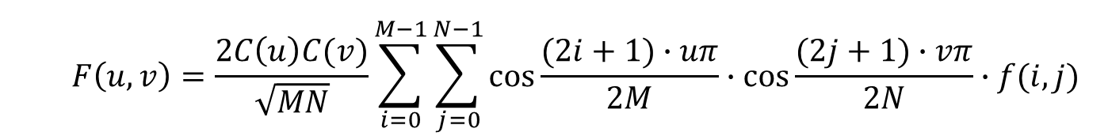
Transform Coding-变换编码
Definition of DCT-离散余弦变换定义
Given an input function $f(i, j)$ over two integer variables i and j (a piece of an image), the 2D DCT transforms it into a new function $F(u, v)$, with integer u and v running over the same range as i and j. The general definition of the transform is-图像像素$f\left(i, j\right):$
$$F\left(u,v\right)=\frac{2C\left(u\right)C(v)}{\sqrt{MN}}\sum_{i=0}^{M−1}{\sum_{j=0}^{N−1}{cos\frac{(2i+1)∙uπ}{2M}∙cos\frac{(2j+1)∙vπ}{2N}}∙f(i, j)}$$
$$i,u=0,1,…M−1, j,v=0,1,…N−1,$$
$$C\left(ξ\right)=\left\{\begin{aligned}\frac{\sqrt{2}}{2}, ξ=0 \\ &1, others\end{aligned}\right.$$

Slide 24

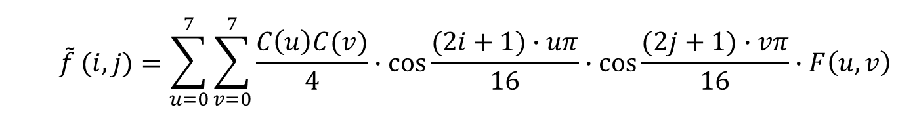
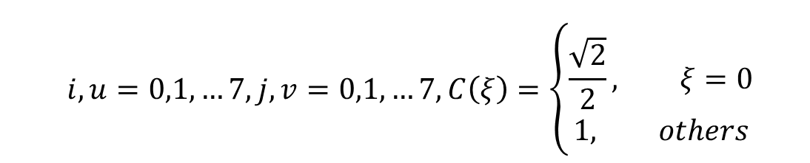
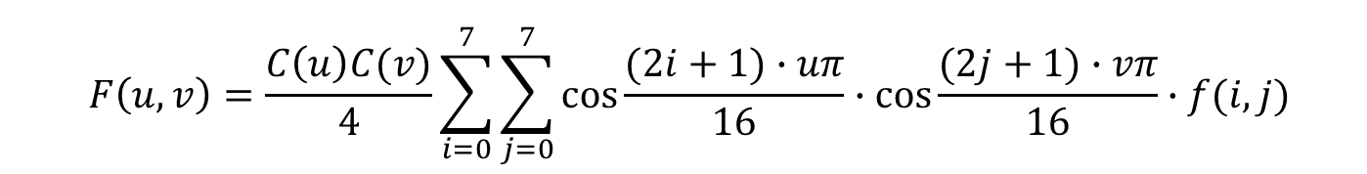
Transform Coding-变换编码
2D DCT and IDCT-二维离散余弦变换及逆变换
In the JPEG image compression standard (see Chap. 9), an image block is defined to have dimension M = N = 8. Therefore, the definitions for the 2D DCT and its inverse (IDCT) are as follows-JPEG图像压缩二维DCT和IDCT$:$
$$F\left(u,v\right)=\frac{C\left(u\right)C(v)}{4}\sum_{i=0}^{7}{\sum_{j=0}^{7}{cos\frac{(2i+1)∙uπ}{16}∙cos\frac{(2j+1)∙vπ}{16}}∙f(i, j)}$$
$$\tilde{f} (i, j)=\sum_{u=0}^{7}{\sum_{v=0}^{7}{\frac{C\left(u\right)C(v)}{4}∙cos\frac{(2i+1)∙uπ}{16}∙cos\frac{(2j+1)∙vπ}{16}}∙F\left(u,v\right)}$$
$$i,u=0,1,…7, j,v=0,1,…7, C\left(ξ\right)=\left\{\begin{aligned}\frac{\sqrt{2}}{2}, ξ=0 \\ &1, others\end{aligned}\right.$$

Slide 25
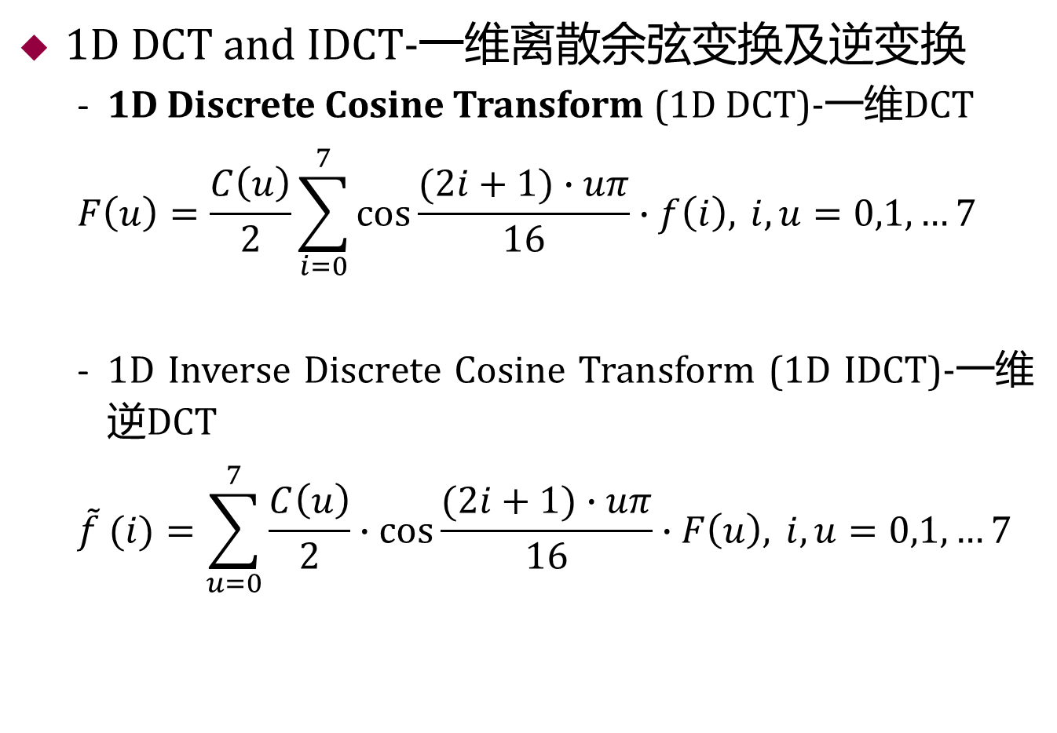
Transform Coding-变换编码
1D DCT and IDCT-一维离散余弦变换及逆变换
1D Discrete Cosine Transform (1D DCT)-一维DCT
$$F\left(u\right)=\frac{C\left(u\right)}{2}\sum_{i=0}^{7}{cos\frac{(2i+1)∙uπ}{16}∙f\left(i\right), }i,u=0,1,…7$$
1D Inverse Discrete Cosine Transform (1D IDCT)-一维逆DCT
$$\tilde{f} (i)=\sum_{u=0}^{7}{\frac{C\left(u\right)}{2}∙cos\frac{(2i+1)∙uπ}{16}∙F\left(u\right), }i,u=0,1,…7$$

Slide 26
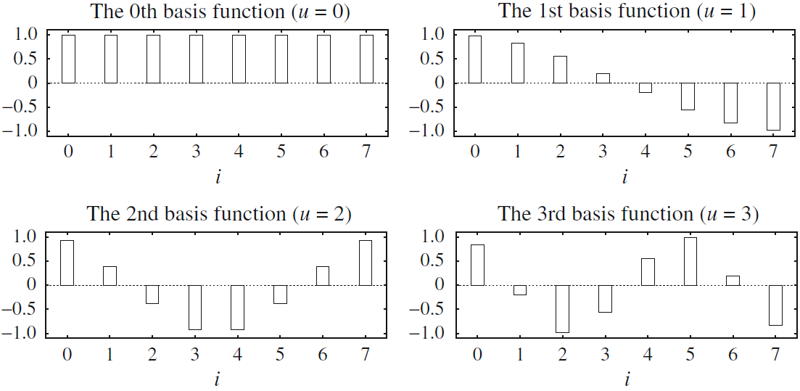

Transform Coding-变换编码
1D DCT basis functions-一维DCT基函数
$$F\left(u\right)=\frac{C\left(u\right)}{2}\sum_{i=0}^{7}{cos\frac{(2i+1)∙uπ}{16}∙f\left(i\right), }i,u=0,1,…7$$

Slide 27
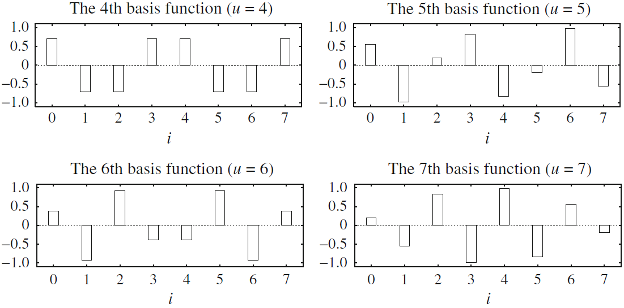
Transform Coding-变换编码
1D DCT basis functions-一维DCT基函数
$$F\left(u\right)=\frac{C\left(u\right)}{2}\sum_{i=0}^{7}{cos\frac{(2i+1)∙uπ}{16}∙f\left(i\right), }i,u=0,1,…7$$

Slide 28
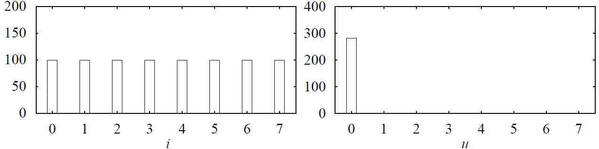
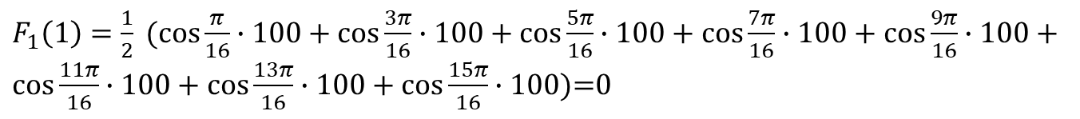

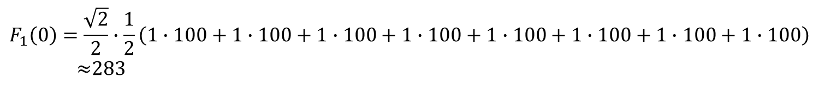
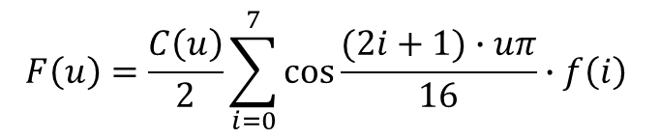
Transform Coding-变换编码
1D DCT -一维离散余弦变换
Example: f₁={100, 100, 100, 100, 100, 100, 100, 100}
${F_{1}\left(1\right)\text{=}F}_{1}\left(2\right)$=, $…{,=F}_{1}\left(7\right)$=0
$$F\left(u\right)=\frac{C\left(u\right)}{2}\sum_{i=0}^{7}{cos\frac{(2i+1)∙uπ}{16}∙f\left(i\right) }$$
$$F_{1}\left(0\right)=\frac{\sqrt{2}}{2}∙\frac{1}{2}\left(1∙100+1∙100+1∙100+1∙100+1∙100+1∙100+1∙100+1∙100\right)$$
$≈$283
$F_{1}\left(1\right)=\frac{1}{2} (cos\frac{π}{16}∙100+cos\frac{3π}{16}∙100+cos\frac{5π}{16}∙100+cos\frac{7π}{16}∙100$ + $cos\frac{9π}{16}∙100+cos\frac{11π}{16}∙100+cos\frac{13π}{16}∙100+cos\frac{15π}{16}∙100$)=0

Slide 29
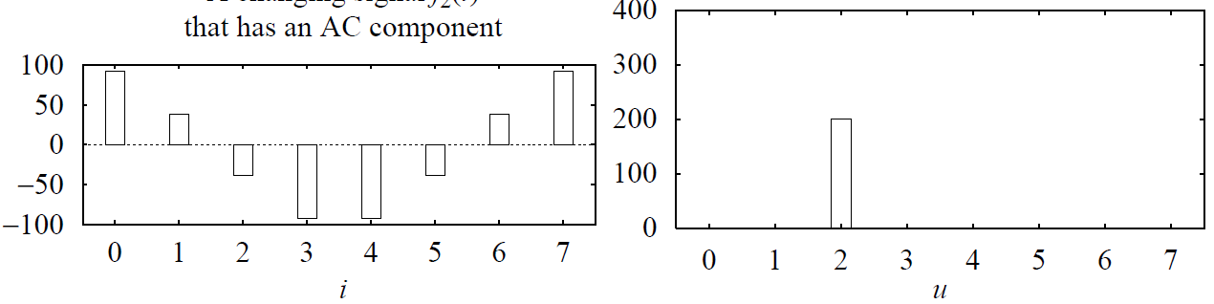

Transform Coding-变换编码
1D DCT-一维离散余弦变换
Example: f₂
包含AC分量的变化信号
$$F\left(u\right)=\frac{C\left(u\right)}{2}\sum_{i=0}^{7}{cos\frac{(2i+1)∙uπ}{16}∙f\left(i\right) }$$
$$F_{2}\left(0\right)=0$$
$$F_{2}\left(2\right)=200$$
$F_{2}\left(1\right)=F_{3}\left(3\right)$=…= $F_{3}\left(7\right)=0$

Slide 30
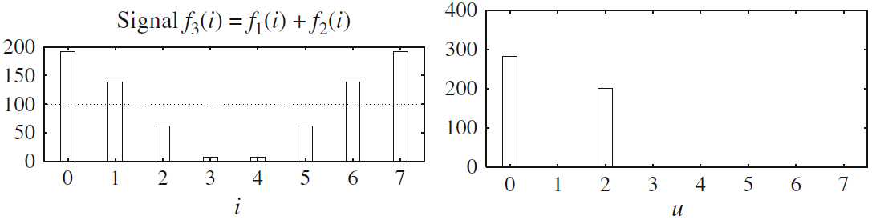
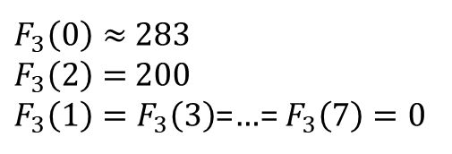
Transform Coding-变换编码
1D DCT-一维离散余弦变换
Example: f₃= f₁+f₂
包含DC+AC分量的变化信号
$$F\left(u\right)=\frac{C\left(u\right)}{2}\sum_{i=0}^{7}{cos\frac{(2i+1)∙uπ}{16}∙f\left(i\right) }$$
$F_{3}\left(0\right)≈$283
$F_{3}\left(2\right)=$200
$F_{3}\left(1\right)=F_{3}\left(3\right)$=…= $F_{3}\left(7\right)=0$

Slide 31
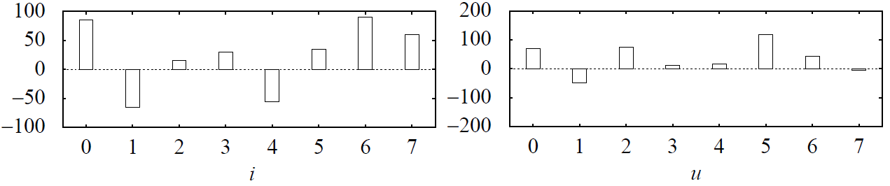
Transform Coding-变换编码
1D DCT-一维离散余弦变换
Example: f₄= {85, −65, 15, 30, −56, 35, 90, 60}
任意变化信号
F₄(u): {69, −49, 74, 11, 16, 117, 44, −5}

Slide 32
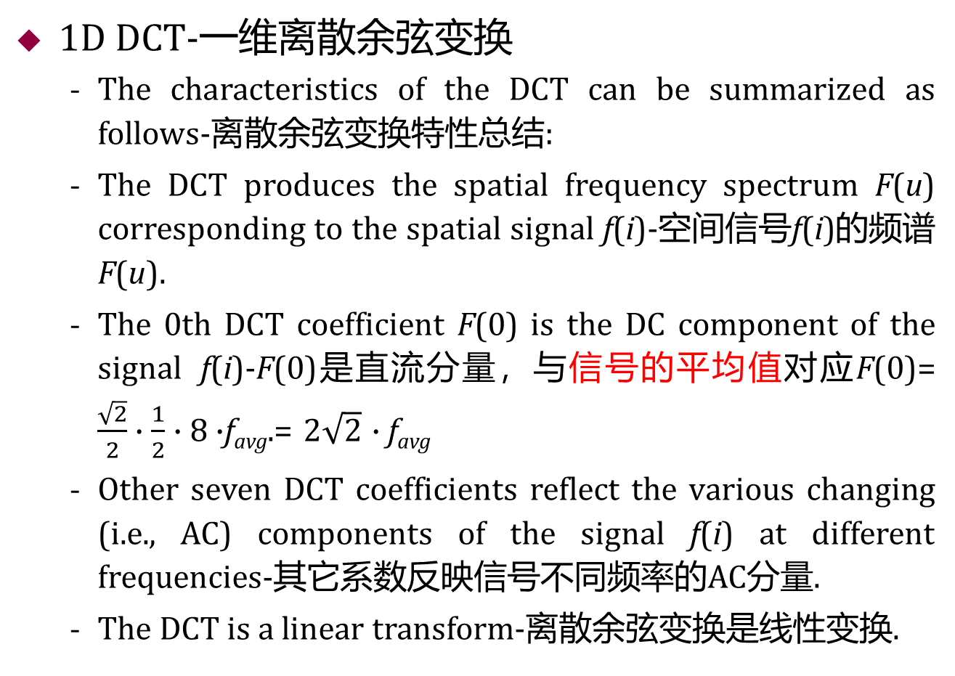
Transform Coding-变换编码
1D DCT-一维离散余弦变换
The characteristics of the DCT can be summarized as follows-离散余弦变换特性总结:
The DCT produces the spatial frequency spectrum F(u) corresponding to the spatial signal f(i)-空间信号f(i)的频谱F(u).
The 0th DCT coefficient F(0) is the DC component of the signal f(i)-F(0)是直流分量，与信号的平均值对应F(0)= $\frac{\sqrt{2}}{2}∙\frac{1}{2}∙$ 8$∙$f_{avg}.= $2\sqrt{2}$ $∙$f_{avg}
Other seven DCT coefficients reflect the various changing (i.e., AC) components of the signal f(i) at different frequencies-其它系数反映信号不同频率的AC分量.
The DCT is a linear transform-离散余弦变换是线性变换.

Slide 33
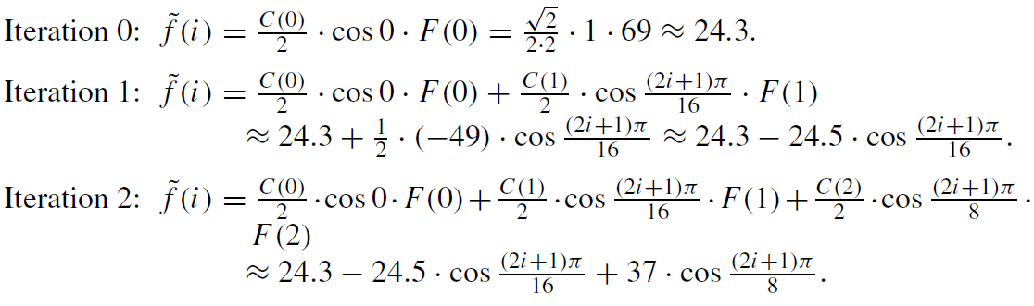

Transform Coding-变换编码
1D IDCT-一维离散余弦逆变换
Example: f₄= {85, −65, 15, 30, −56, 35, 90, 60}
F₄(u): {69, −49, 74, 11, 16, 117, 44, −5}
$$\tilde{f} (i)=\sum_{u=0}^{7}{\frac{C\left(u\right)}{2}∙cos\frac{(2i+1)∙uπ}{16}∙F\left(u\right) }$$

Slide 34
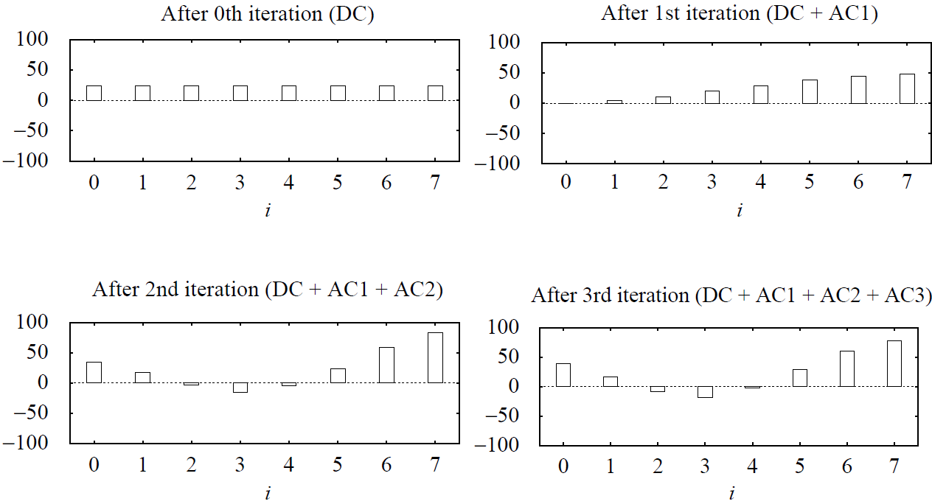
Transform Coding-变换编码
1D IDCT-一维离散余弦逆变换
Example: f₄= {85, −65, 15, 30, −56, 35, 90, 60}
F₄(u): {69, −49, 74, 11, 16, 117, 44, −5}

Slide 35
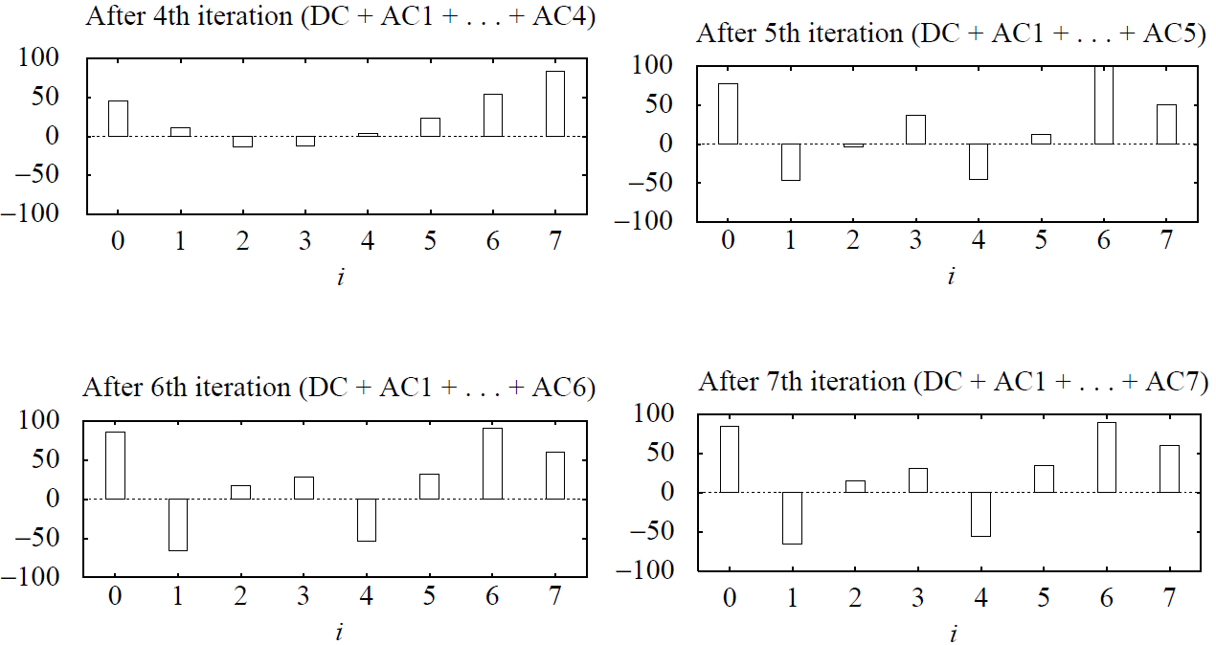

Transform Coding-变换编码
1D IDCT-一维离散余弦逆变换
Example: f₄= {85, −65, 15, 30, −56, 35, 90, 60}
F₄(u): {69, −49, 74, 11, 16, 117, 44, −5}
$\tilde{f}(i)$: {85, −65, 15, 30, −56, 35, 90, 60}.

Slide 36
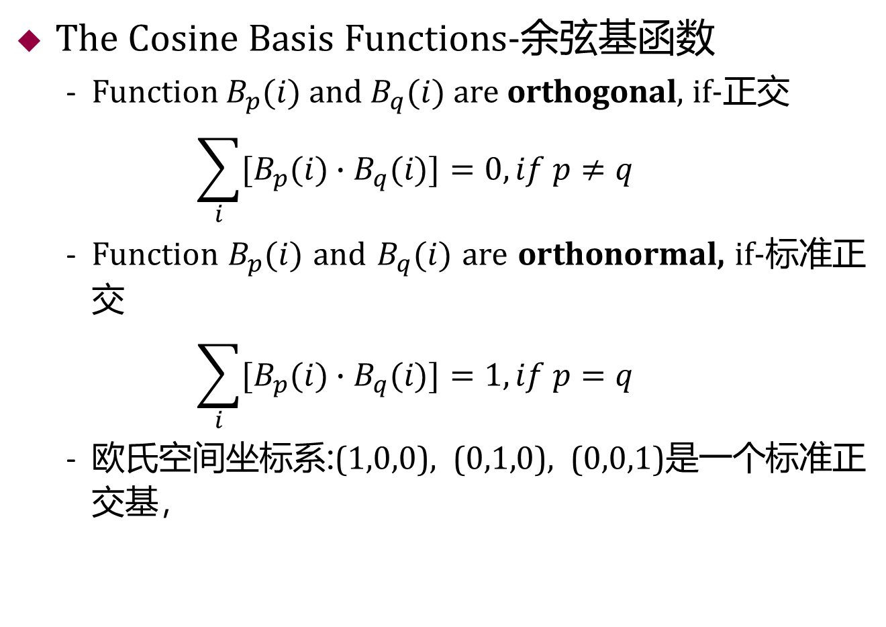
Transform Coding-变换编码
The Cosine Basis Functions-余弦基函数
Function $B_{p}(i)$ and $B_{q}(i)$ are orthogonal, if-正交
$$\sum_{i}{{[B}_{p}(i)∙B_{q}(i)]}=0, if p≠q$$
Function $B_{p}(i)$ and $B_{q}(i)$ are orthonormal, if-标准正交
$$\sum_{i}{{[B}_{p}(i)∙B_{q}(i)]}=1, if p=q$$
欧氏空间坐标系:(1,0,0), (0,1,0), (0,0,1)是一个标准正交基，

Slide 37
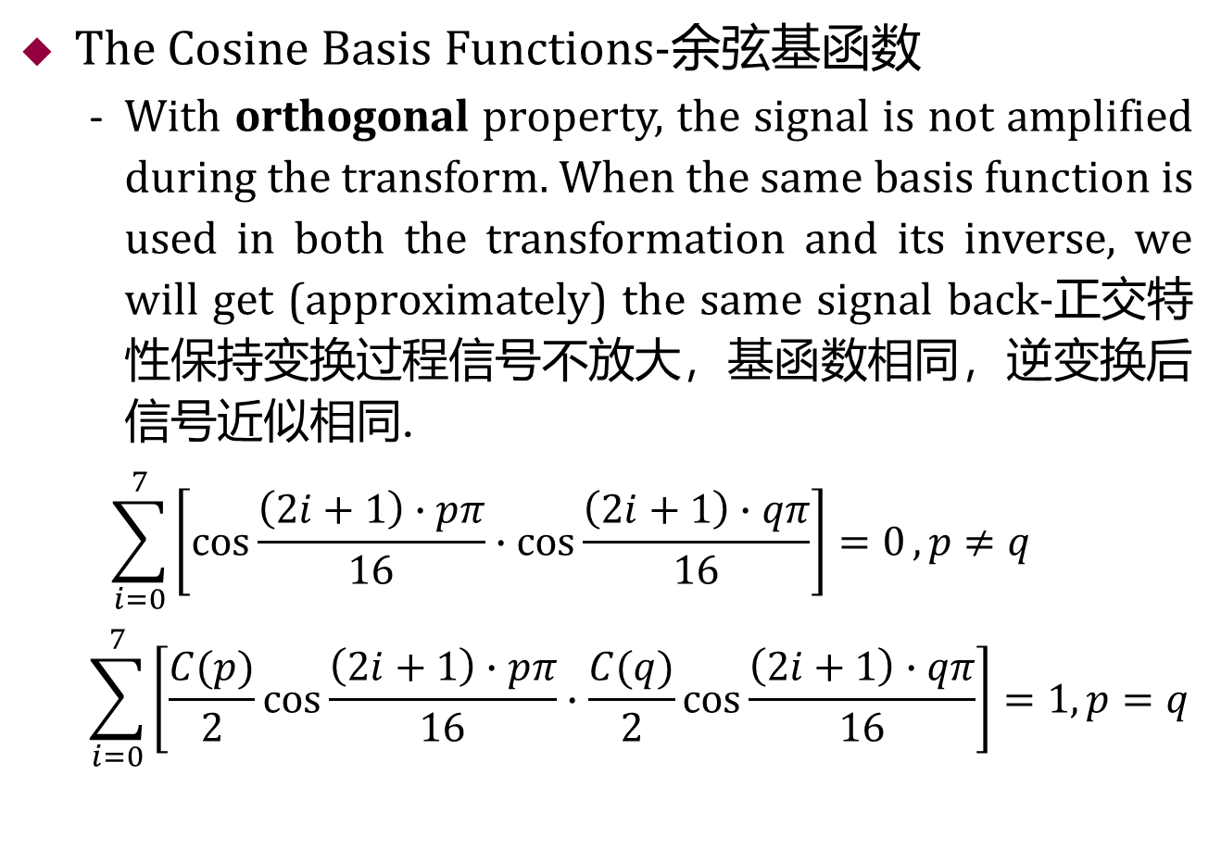
Transform Coding-变换编码
The Cosine Basis Functions-余弦基函数
With orthogonal property, the signal is not amplified during the transform. When the same basis function is used in both the transformation and its inverse, we will get (approximately) the same signal back-正交特性保持变换过程信号不放大，基函数相同，逆变换后信号近似相同.
$$\sum_{i=0}^{7}{\left[cos\frac{\left(2i+1\right)∙pπ}{16}∙cos\frac{\left(2i+1\right)∙qπ}{16}\right]=0},p≠q$$
$$\sum_{i=0}^{7}{\left[\frac{C(p)}{2}cos\frac{\left(2i+1\right)∙pπ}{16}∙\frac{C(q)}{2}cos\frac{\left(2i+1\right)∙qπ}{16}\right]=1, p=q}$$
标准化参数

Slide 38
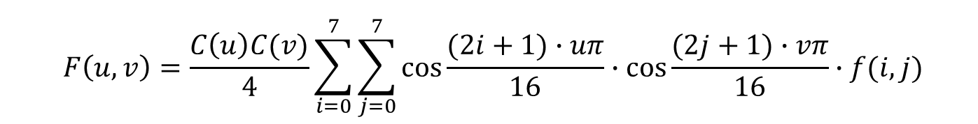
Transform Coding-变换编码
2D Basis Functions-2D基函数
For two-dimensional DCT functions, we use the basis depicted as 8 × 8 image. For a particular pair of u and v, the respective basis function is-具体的对(u, v) 相应基函数:
$$F\left(u,v\right)=\frac{C\left(u\right)C(v)}{4}\sum_{i=0}^{7}{\sum_{j=0}^{7}{cos\frac{(2i+1)∙uπ}{16}∙cos\frac{(2j+1)∙vπ}{16}}∙f(i, j)}$$

Slide 39
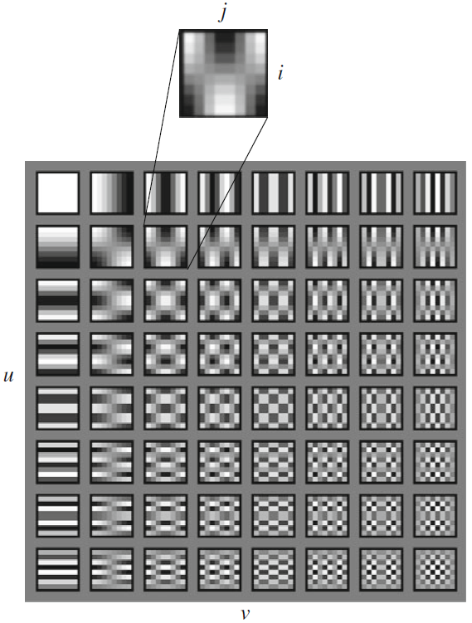
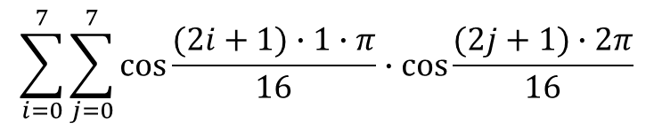
Transform Coding-变换编码
2D Basis Functions-2D基函数
$$\sum_{i=0}^{7}{\sum_{j=0}^{7}{cos\frac{(2i+1)∙1∙π}{16}∙cos\frac{(2j+1)∙2π}{16}}}$$

Slide 40
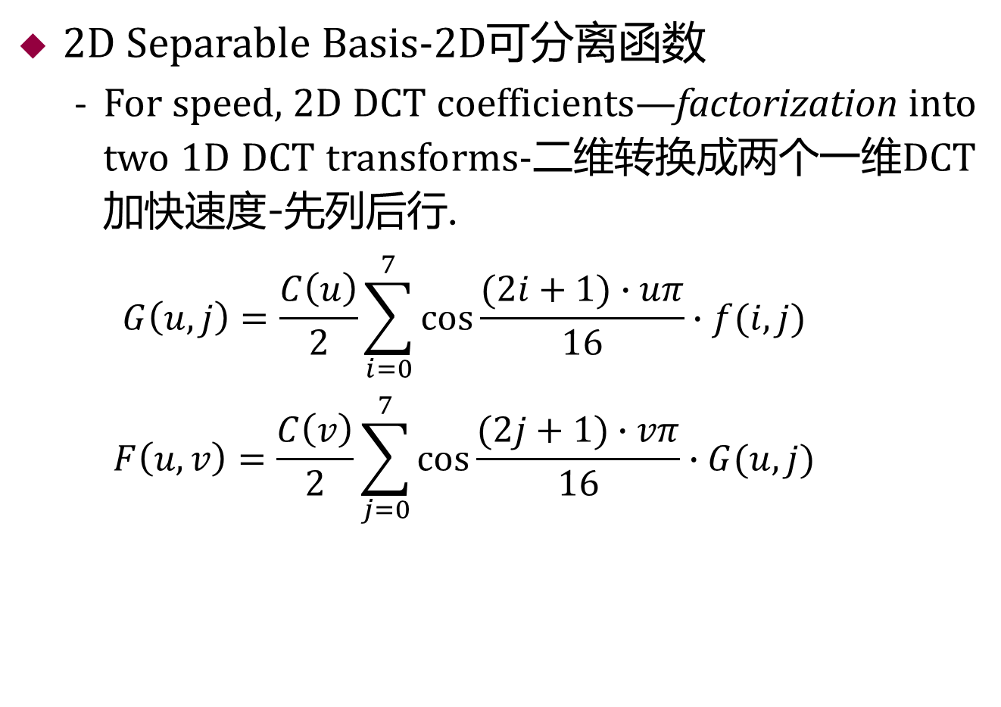
Transform Coding-变换编码
2D Separable Basis-2D可分离函数
For speed, 2D DCT coefficients—factorization into two 1D DCT transforms-二维转换成两个一维DCT加快速度-先列后行.
$$G\left(u,j\right)=\frac{C\left(u\right)}{2}\sum_{i=0}^{7}{cos\frac{(2i+1)∙uπ}{16}∙f(i, j) }$$
$$F\left(u,v\right)=\frac{C\left(v\right)}{2}\sum_{j=0}^{7}{cos\frac{(2j+1)∙vπ}{16}∙G(u, j) }$$

Slide 41
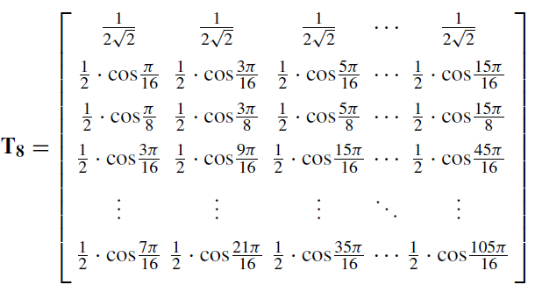

Transform Coding-变换编码
2D DCT-Matrix Implementation-矩阵实现
The above factorization of a 2D DCT into two 1D DCTs can be implemented by two consecutive matrix multiplications-二维转换矩阵乘法实现.
$$F\left(u,v\right)=T∙f(i, j)∙T^{T}$$
DC
AC1
AC2
AC3
AC7
DCT矩阵

Slide 42
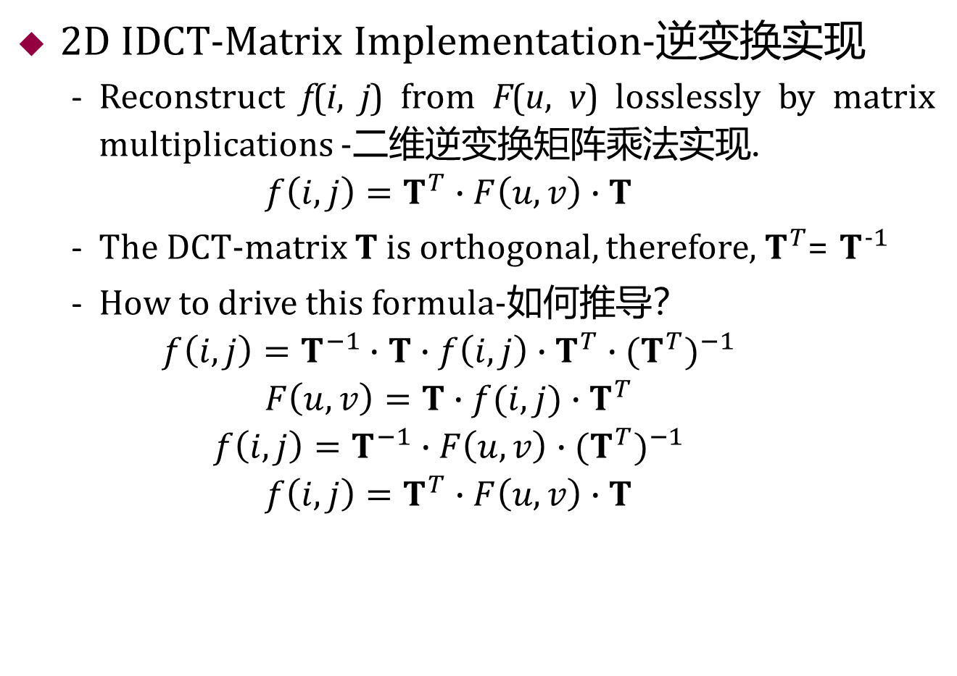
Transform Coding-变换编码
2D IDCT-Matrix Implementation-逆变换实现
Reconstruct f(i, j) from F(u, v) losslessly by matrix multiplications -二维逆变换矩阵乘法实现.
$$f\left(i, j\right)=T^{T}∙F\left(u,v\right)∙T$$
The DCT-matrix T is orthogonal, therefore, $T^{T}$= $T^{−1}$
How to drive this formula-如何推导？
$$f\left(i, j\right)=T^{−1}∙T∙f\left(i, j\right)∙T^{T}∙{(T^{T})}^{−1}$$
$$F\left(u,v\right)=T∙f(i, j)∙T^{T}$$
$$f\left(i, j\right)=T^{−1}∙F\left(u,v\right)∙{(T^{T})}^{−1}$$
$$f\left(i, j\right)=T^{T}∙F\left(u,v\right)∙T$$
Notes:
DCT矩阵T是正交矩阵，有T^t=T^(-1)

Slide 43
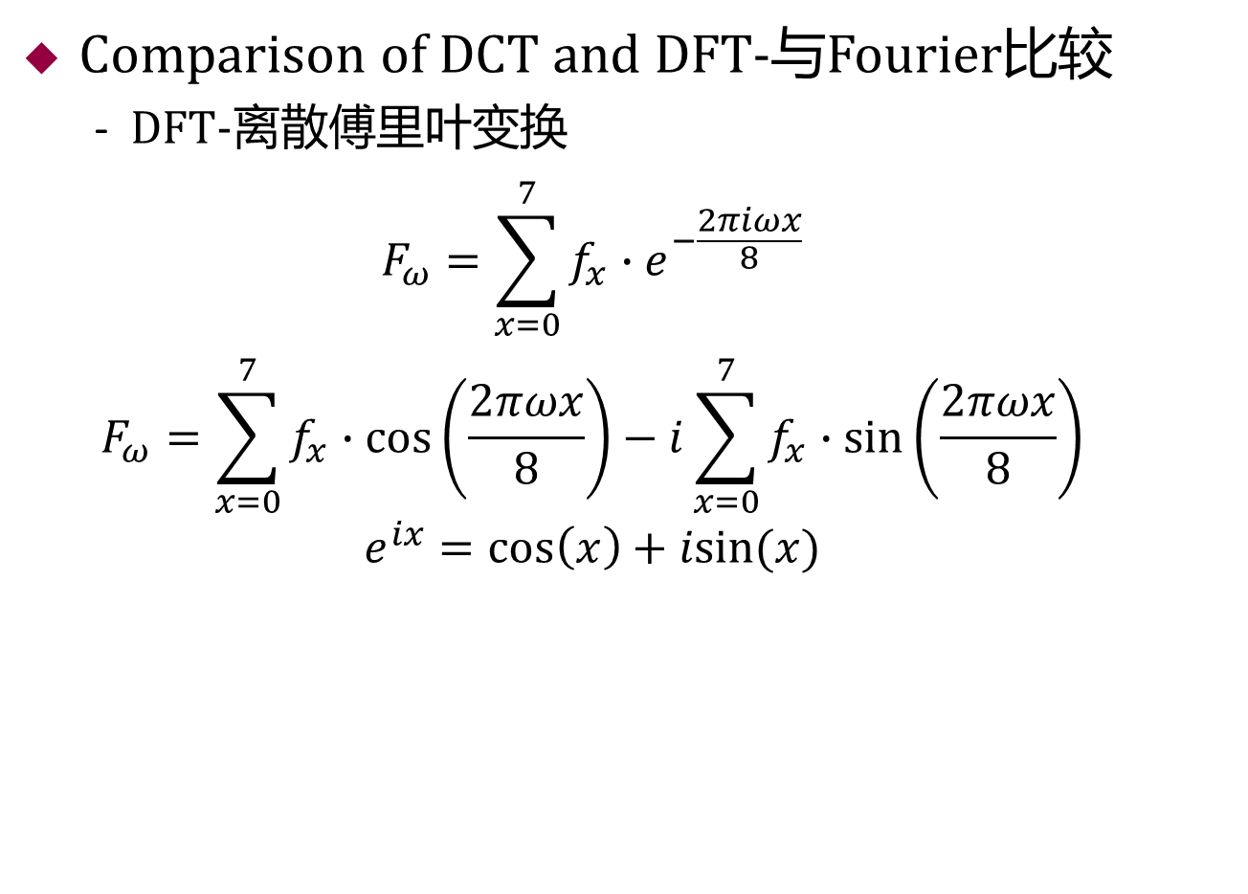
Transform Coding-变换编码
Comparison of DCT and DFT-与Fourier比较
DFT-离散傅里叶变换
$$F_{ω}=\sum_{x=0}^{7}{f_{x}∙e^{−\frac{2πiωx}{8}}}$$
$$F_{ω}=\sum_{x=0}^{7}{f_{x}∙cos\left(\frac{2πωx}{8}\right)−i\sum_{x=0}^{7}{f_{x}∙sin\left(\frac{2πωx}{8}\right)}}$$
$$e^{ix}=\cos\left(x\right)+isin(x)$$

Slide 44
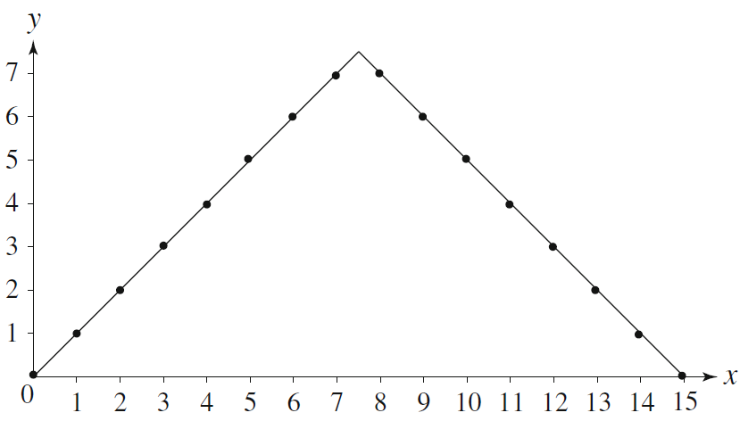
Transform Coding-变换编码
Comparison of DCT and DFT-与Fourier比较
Symmetric extension of the ramp function-对称斜坡函数

Slide 45
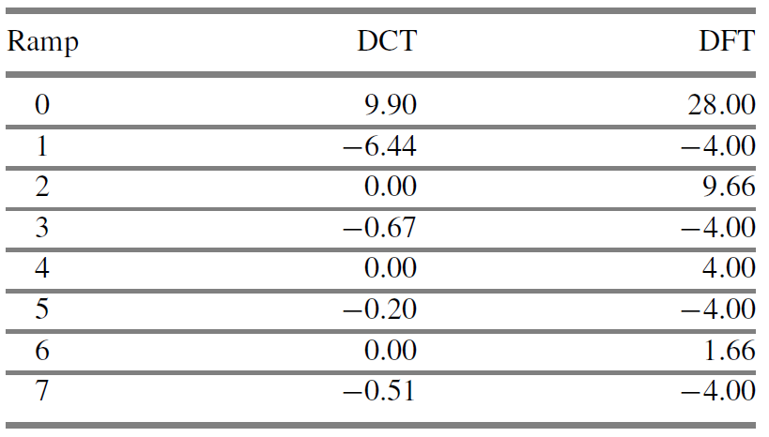
Transform Coding-变换编码
Comparison of DCT and DFT-与Fourier比较
DCT and DFT coefficients of the ramp function
DCT前几个系数包含更多的信息

Slide 46

Transform Coding-变换编码
Comparison of DCT and DFT-与Fourier比较
Approximation of the ramp function: (a) 3 Term DCT Approximation, (b) 3 Term DFT Approximation.

Slide 47
Outline of Lecture 08
Introduction-简介
Distortion Measures-失真度量
The Rate-Distortion Theory-比率失真理论
Quantization-量化
Uniform Scalar Quantization-均匀标量量化
Nonuniform Scalar Quantization-非均匀标量量化
Vector Quantization-向量量化
Transform Coding-变换编码
Wavelet-Based Coding-小波编码
Experiments-实验

Slide 48
Transform Coding-变换编码
Wavelet-Based Coding-小波编码
The objective of the wavelet transform is to decompose the input signal into components that are easier to deal with, have special interpretations, or have some components that can be thresholded away, for compression purposes-小波变换.
We want to be able to at least approximately reconstruct the original signal given these components.
The basis functions of the wavelet transform are localized in both time and frequency.
There are two types of wavelet transforms: the continuous wavelet transform (CWT) and the discrete wavelet transform (DWT)-连续和离散小波.

Slide 49

Transform Coding-变换编码
Wavelet-Based Coding-小波编码
The discrete wavelet transform (DWT).
The two-dimensional discrete wavelet transform (a) One level transform,
(b) two level transform.

Slide 50

Transform Coding-变换编码
Wavelet-Based Coding-小波编码
The discrete wavelet transform (DWT).

Slide 51

Experiments & Class Assignments
Experiments-Matlab命令行输入:”wavemenu”

Slide 52

Experiments & Class Assignments
Experiments-Matlab命令行输入:”wavemenu”

Slide 53
Experiments & Class Assignments
Experiments
DCT Coding--ch08_dct_demo.m
Wavelet Coding--ch08_dwt_demo.m
Class Assignments
1、已知原来的数据为{12 16 16 12 12 8 8 12 }、经过压缩与解压缩之后得到的数据为{12 12 12 8 12 8 12 12}. 请分别计算MSE、SNR和PSNR的值，请写出计算过程， 其中log₁₀(32) ≈1.505, log₁₀(19) ≈1.279.
2、输入信号为f(i)=[0 10 20 30 40 50 60 70]，请计算该信号的一维离散余弦变换的F(0).
3、变换编码的基本原理是什么？

